Slide 1
PROJECT REPORT ON RESTAURANT MANAGEMENT SYSTEM

Slide 2
INTRODUCTION
The Restaurant Management System is an essential tool for any restaurant, it helps the restaurant manager to manage the restaurant more effectively and efficiently by computerizing meal ordering and billing. These systems are designed to keep your restaurant running by tracking your employees inventory and sales. The system processes transaction and stores the resulting data in database of management system. RMS is a comprehensive tool which allows you to see your restaurant and its need at a glance which can simplify your work on daily basis. Multiple people are associated with RMS.
Manager
Waiter
Rider

Slide 3
OBJECTIVE
A computer based management system is designed to handle all primary information required to calculate monthly statement.
This project intends to introduce more user friendliness in the various activities such as record updating, maintenance and searching.
Delivery of orders and order tracking is made easier as everything related to these activities is explicit and simple.

Slide 4
PURPOSE
The main purpose of the Online Restaurant Management System is to reach to wider range of restaurant employees and to educate them about use of online tools for the sake of simplicity and for doing their job without much effort.
One more purpose is to allow restaurant employees to keep track of their work so that there is less chance of mistakes.
Allow customer to pay and complain about any problem online, when the complain is solved, they can get feedback online too.
This system reduces the time consumption.
This project helps the management to know customers order details in few seconds.

Slide 5
HARDWARE REQUIREMENT
Hardware requirements are as follows:
Processor Dual-Core CPU;
Installed Memory (RAM)- at least 2GB;
System type-32 bit or 64 bit Operating System;
Resolution-1366x768

Slide 6
SOFTWARE REQUIREMENT
Software requirements are as follows:
Node.js 10.x
MongoDB 4.0
MongoDB server 4.0.x: mongoose ^5.2.0
Npm 6.14.13

Slide 7
FEATURES
Rider Attendance
Order new Stock
Availability of Stock
Manager Attendance
Janitor Attendance
Waiter Attendance
Generate Salary
View Order
Accept Order

Slide 8
FEATURES
Status of Order
Report Issue
View Issue
Resolve Issue
Liabilities
Cash in Till
Clean Table
Clean Washroom
Management Staff(Assignment of duties)

Slide 9
FEATURES
Home Delivery
Add/Remove Stock
Offer Discount
Reservation

Slide 10
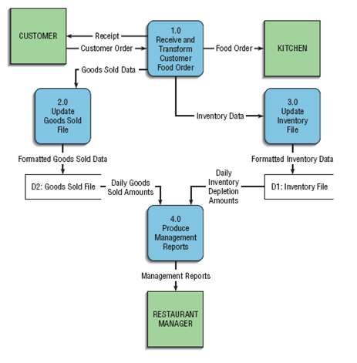
DATA FLOW DIAGRAM

Slide 11
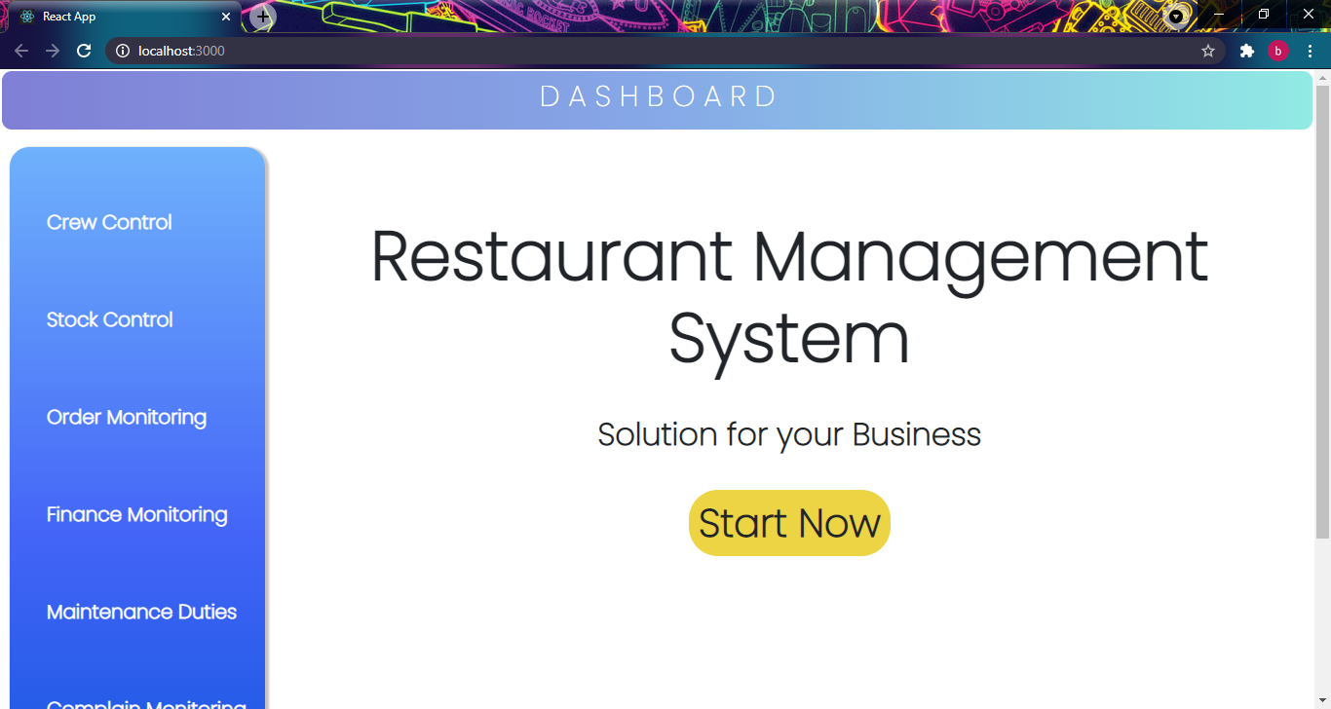
HOME PAGE

Slide 12
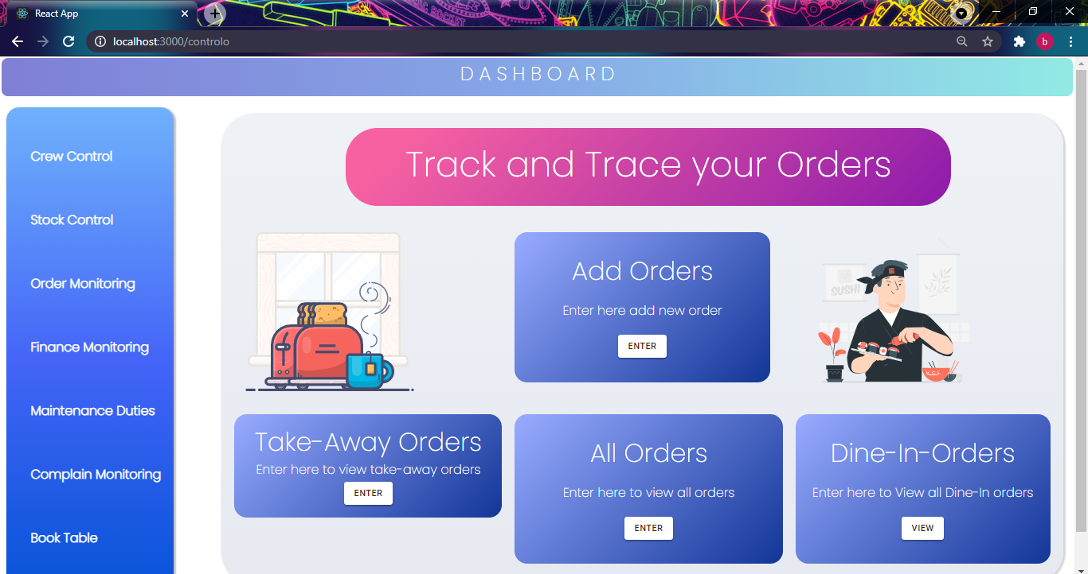
ORDERS SCREEN

Slide 13
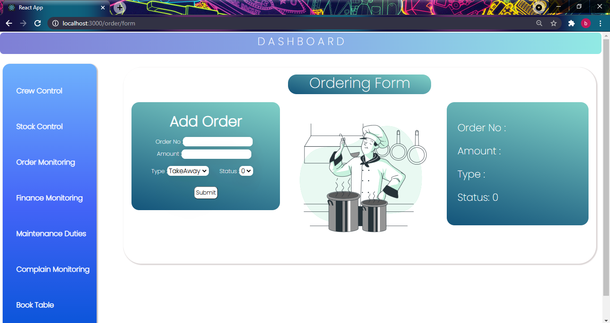
ORDER DETAILS

Slide 14
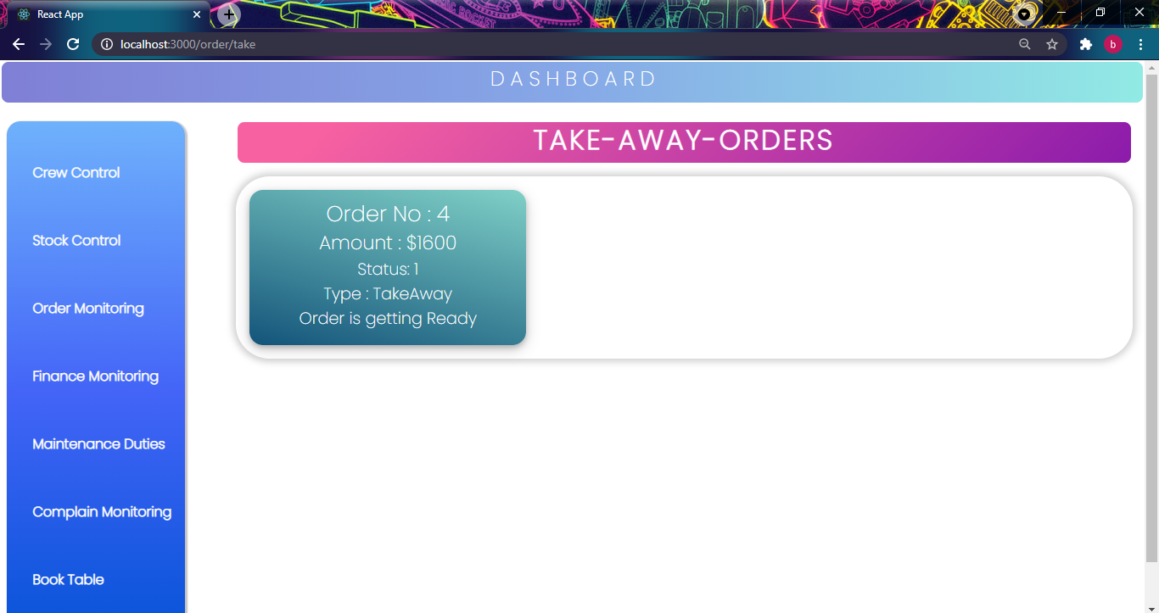
TAKE-AWAY ORDERS

Slide 15
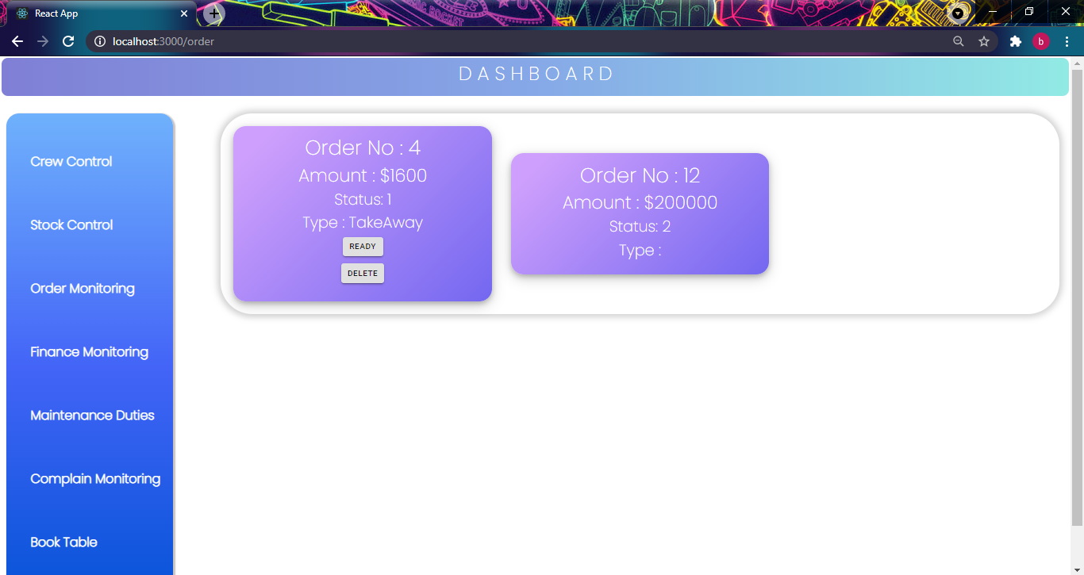
ORDER STATUS

Slide 16
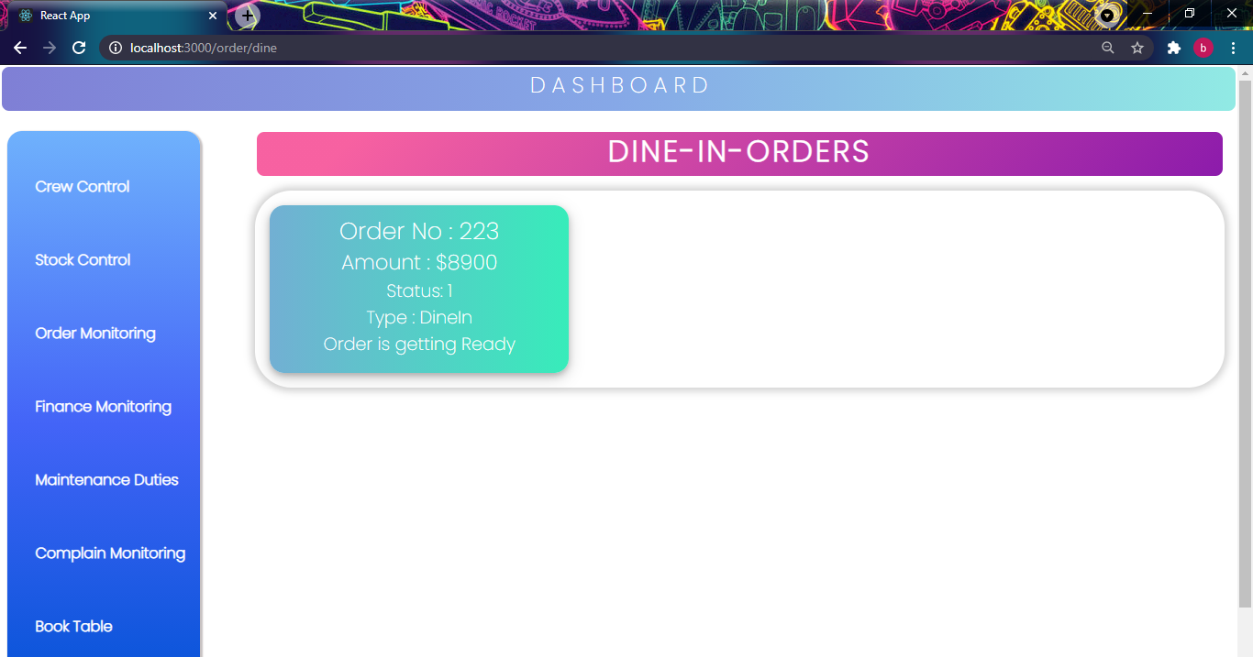
DINE-IN ORDERS

Slide 17
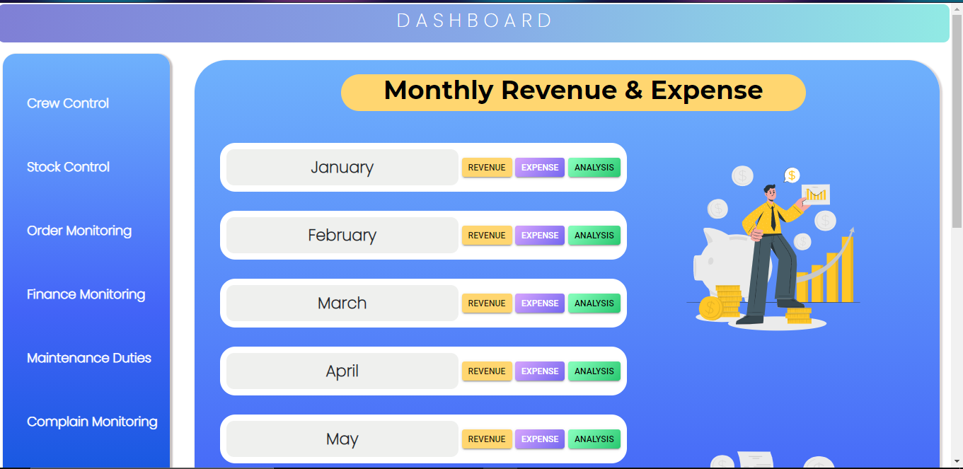
REVENUE & EXPENSES

Slide 18
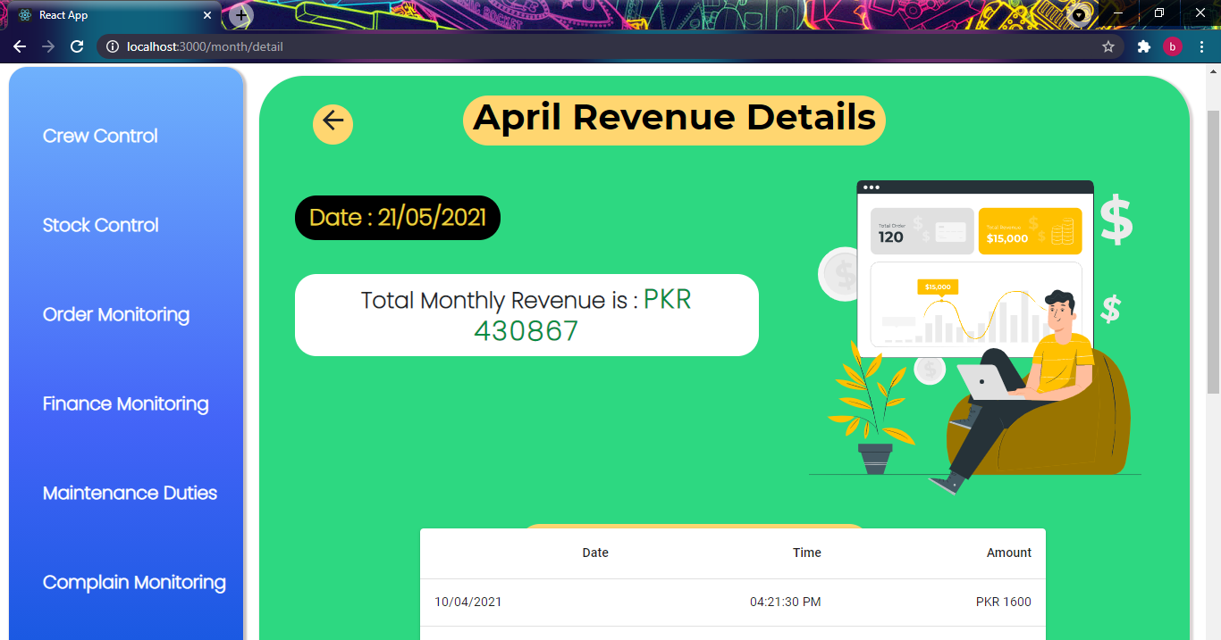
REVENUE DETAILS

Slide 19
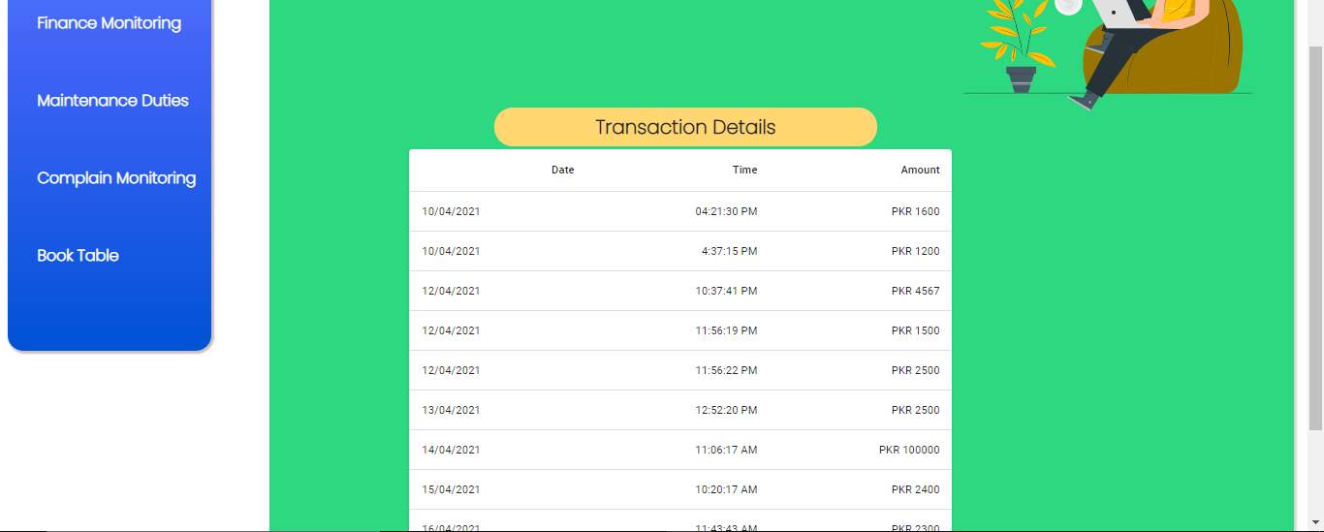
TRASNACTIONS RECORD

Slide 20
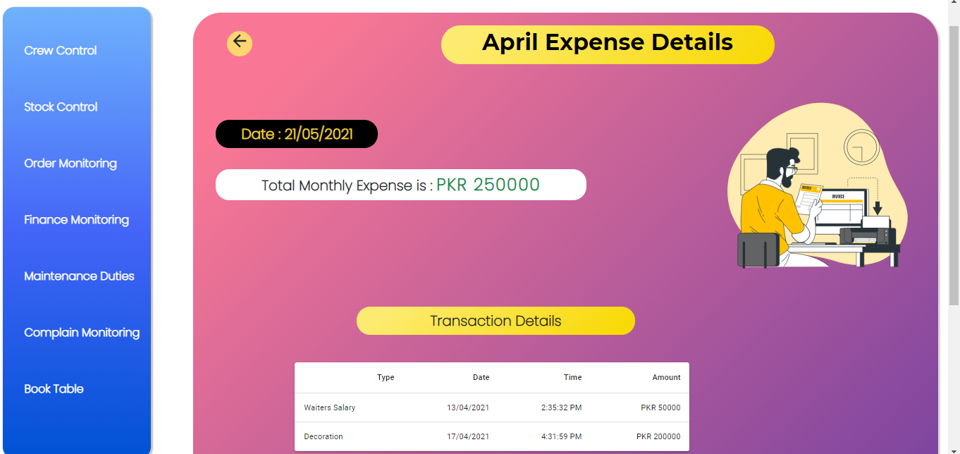
EXPENSES DETAILS

Slide 21
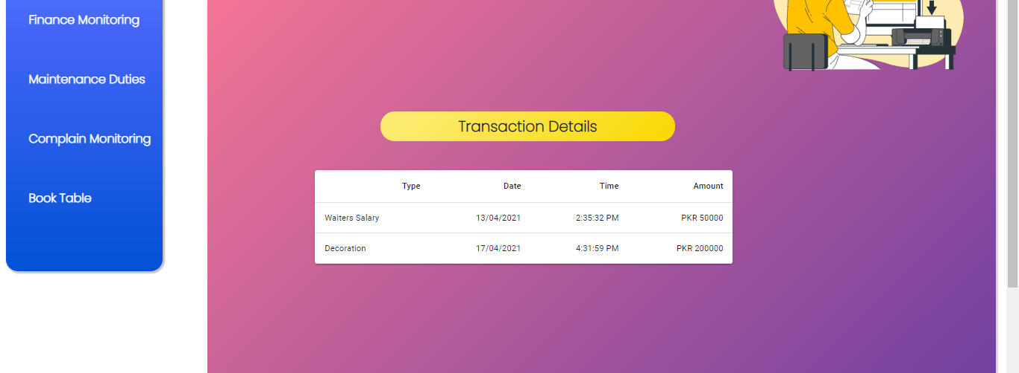
EMPLOYEES SALARY INFO

Slide 22
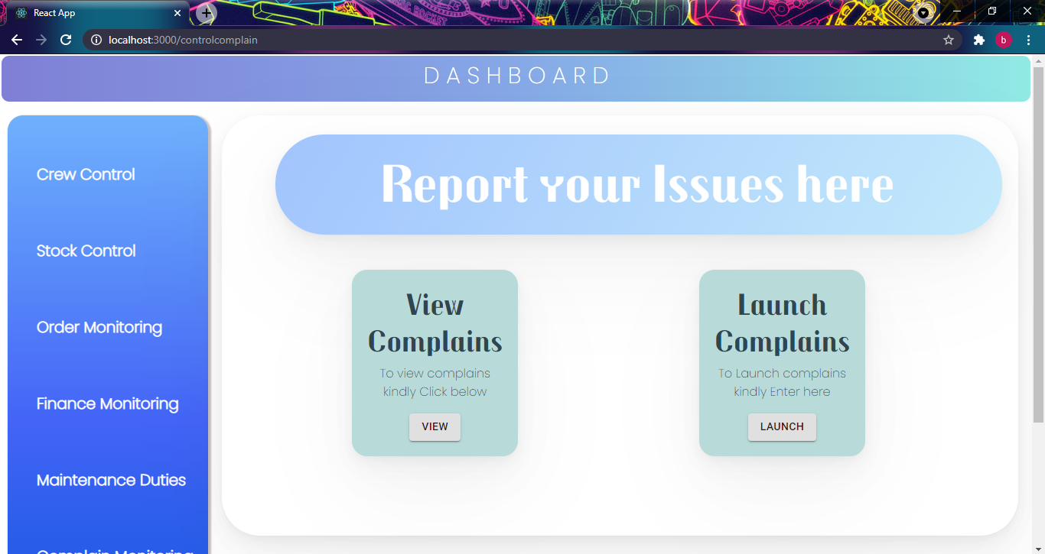
COMPLAINS RELATED ACTIONS

Slide 23
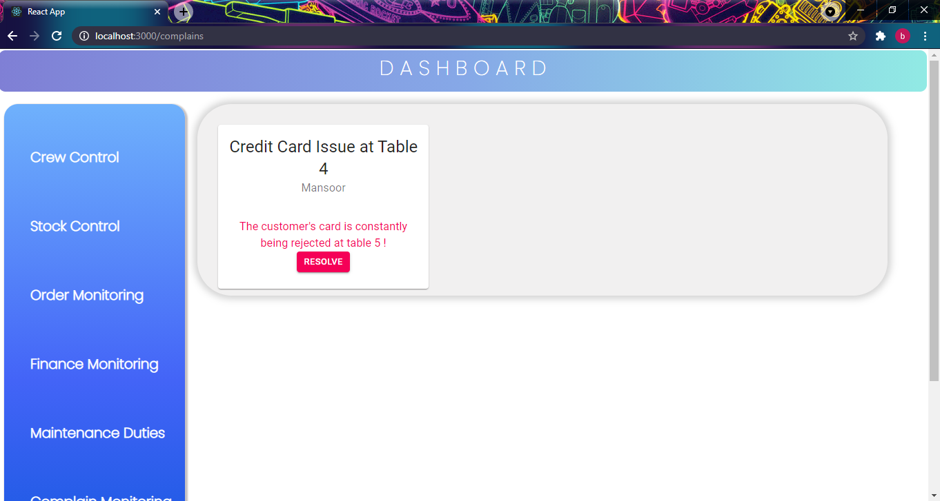
COMPLAINS RELATED ACTIONS

Slide 24
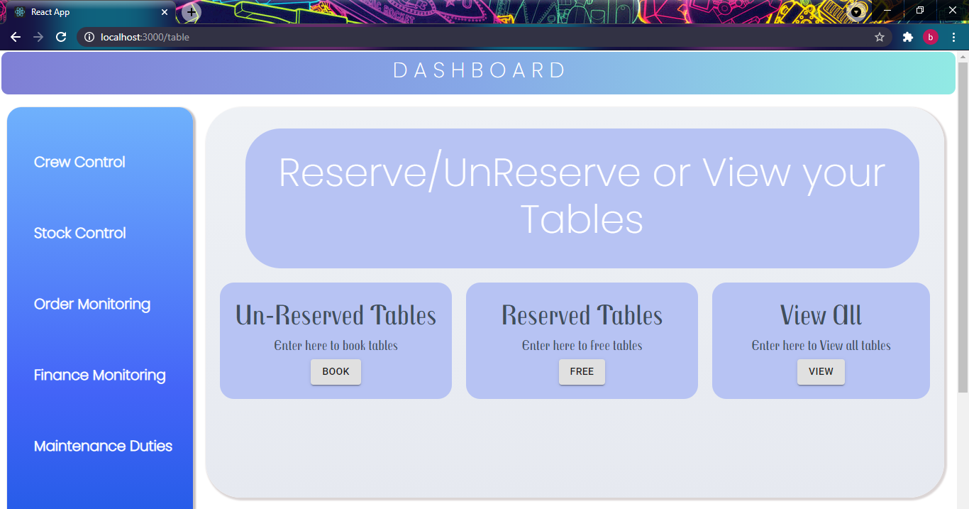
TABLES DETAILS

Slide 25
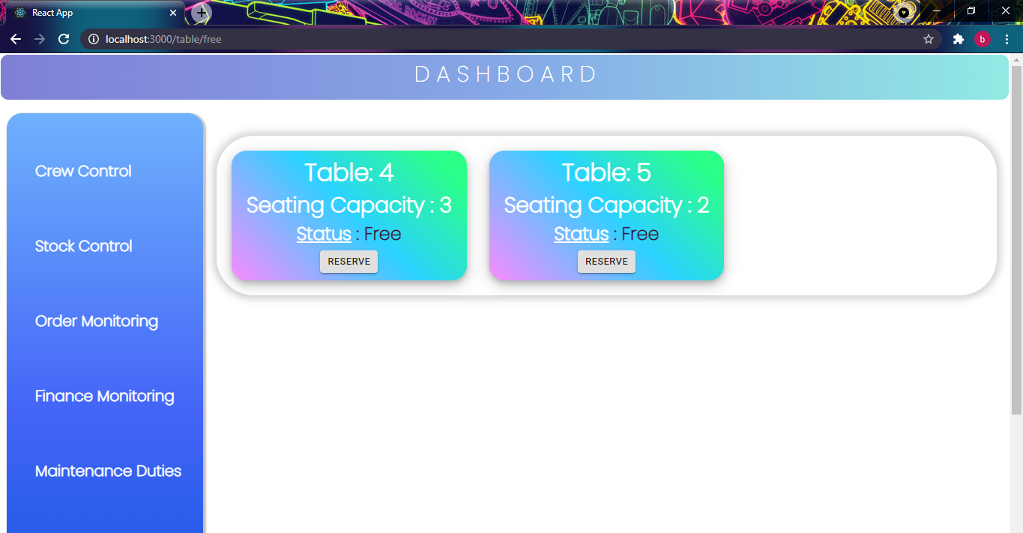
TABLES DETAILS

Slide 26
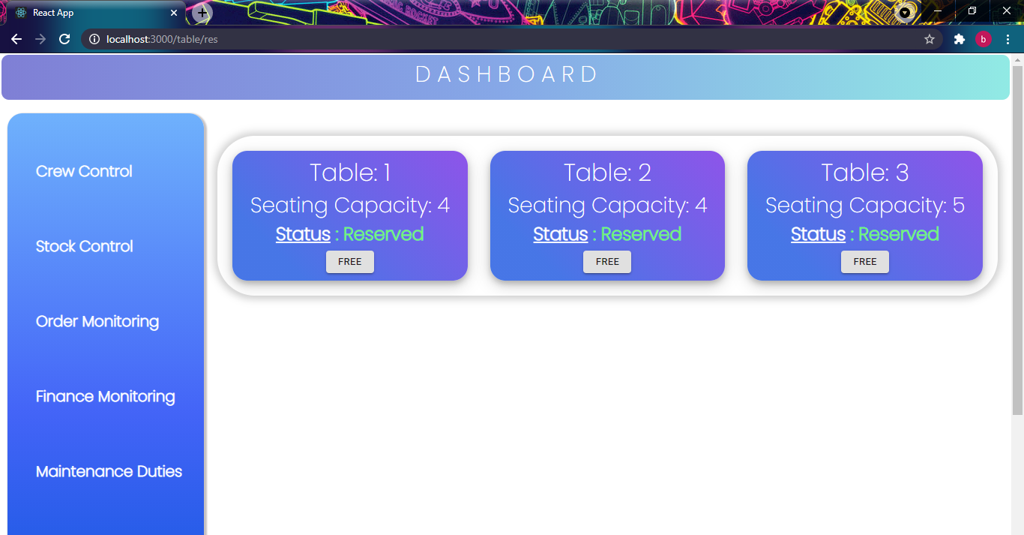
TABLES RESERVATION

Slide 27
Future Work
Allow customers to customize food orders and reservation system.
Allow to save payment details for future use.
Allow an attendance system for the employees.
Generate salary for employees.
Assign duties to employees online.

Slide 28
CONCLUSION
This is achieved through easy to use graphical interface menu options. After customer makes an order, he decides if he want dine-in or take away order. Incase of take away, rider will be assigned the order and for dine-in, waiter will be assigned. Waiter will check online for unreserved tables, he can also free tables and finally serve customers. Manager can also perform his duties like updating stock, managing employees and assign duties.

Slide 29
THANK YOU!

